Slide 1
INVESTMENT CASE STUDY SUBMISSION
Group Name:
Nirmal Maheshwari
Vijaya Gupta
Shwetank Pandey
Pranjal Paliwal

Slide 2
Abstract
Sparks Fund Management is an Assent Management Company looking to make investments in few companies. They want to understand Global trends in investment so they can make investment decisions effectively.
Presentation helps them with their decisions by analysing the Market trends on three basis.
Best Funding Type
Top Country for Investment.
Top Sector for Investment.
Strategy – Basic Strategy is to invest where others are investing, this is kept in mind while doing all three above analysis.
Constraints –
Investment Capital has to be between 5Mn-15Mn dollars.
Country of Investment should have English as Official Language.

Slide 3

Problem Solving Methodology- CRISP DM Framework
Business Objective : Explained Above Slide
Data : Present in Excel Format, Information about all companies and
details about Investment in them and mapping of primary sectors
to their main sectors
Data Preparation : Cleaning of the data available by replacing the NA
values with meaningful values wherever necessary.
Modelling: Applying a Model following the constraints above and sorting
the results step by step coming to a conclusion for completing the objective.
Evaluation: Evaluating the results in different tools, reviewing the
process and summarizing the results keeping the business success
constraints in mind(Above Slide)
. Tools Used : R, Excel, Tableau

Slide 4
Funding Type Analysis
Strategy And Steps Followed
Reading Excel Data available in R.
Merging of the Data in a single master frame for further analysis.
Replacing the NA values of the funding amount to unique value so the records with them can be discarded in further analysis.
Choices was to either not to include them for further analysis or impute them with mean or median. We decided to not include them as the data is very skewed and the count of them is very high (17%) , so it will change the analysis very much if we include them .
Found out the average investment in the asked funding types (venture, angel, seed, and private equity) and for which ever type the constraint of 5Mn -15 Mn is fulfilled that type is chosen as the required Funding type.
Plot of the analysis is included in the coming slides.( Plot 1)

Slide 5
Country Analysis
Strategy And Steps Followed
Filtered the master frame with the funding type calculated above.
Import the English Speaking Countries PDF provided along with the data.
Narrowing it down to top 9 (top9 Frame) countries ( English and Non English) by aggregating it on the basis of sum of investments made in the countries in descending order.
Adding the flag of English and Non English Speaking Countries to the top9 Frame so top 3 English Speaking countries can be filtered out.
Plot of the analysis is included in the coming slides.( Plot 2)

Slide 6
Sector Analysis
Strategy And Steps Followed
Extracting the primary sector from the category list given with the companies data, and adding it to the master frame
Merging the mapping data with the master data frame so that the primary sector extracted above will be mapped to its main sector.
Filtering from the master frame three different frames for the top 3 English speaking countries following the constraints of capital and the funding type calculated above.
Aggregating the three frames on main sectors with the investment raised in each sector to get the top 3 sectors in each countries.
Plot of the analysis is included in the coming slides.( Plot 3)

Slide 7
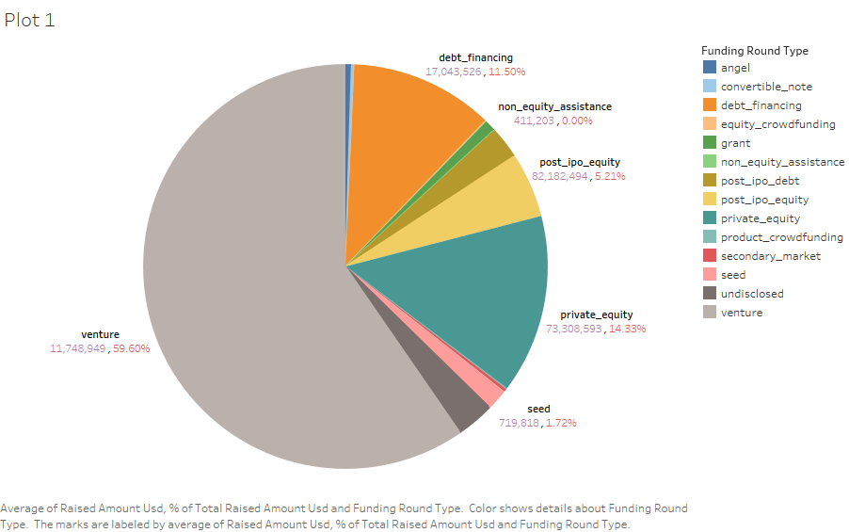
Result : Venture Investment Type

Slide 8
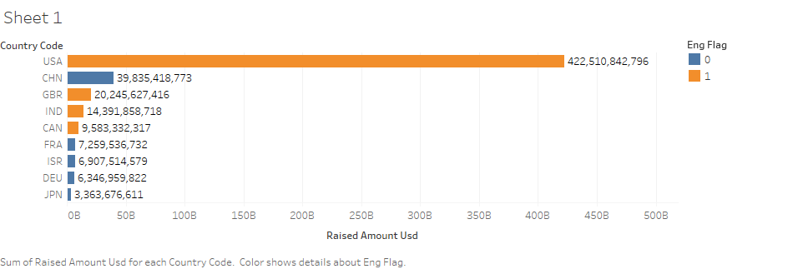
Result : USA( Top English Country)
Plot 2 : Eng Flag: 0- English Not Official language, 1- English Official Language

Slide 9
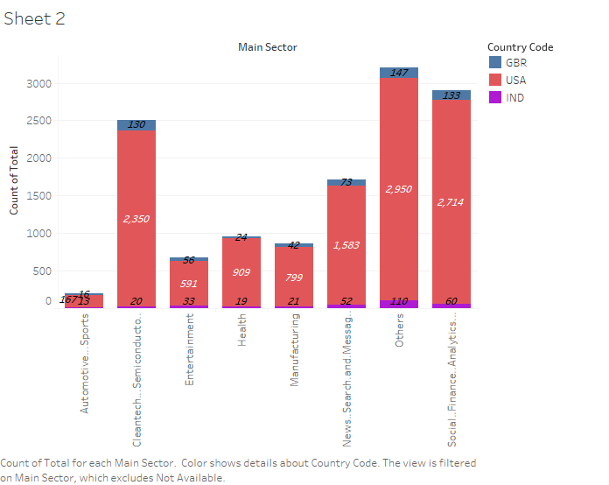
Result : Others( Top Sector in all three countries)
Plot 3

Slide 10
Conclusions
BEST Funding Type - Venture
Top 3 English Speaking Countries – USA, GBR, INDIA
Top 3 Sectors In Each Country
USA:
Others
Social..Finance..Analytics..Advertising
Cleantech...Semiconductors
GBR:
Others
Social..Finance..Analytics..Advertising
Cleantech...Semiconductors
INDIA:
Others
Social..Finance..Analytics..Advertising
News...Search.and..Messaging

